Slide 1
VLAN Trunks and EtherChannel Bundles
Learning Outcomes:
VLAN Trunking Protocol (VTP)
Dynamic Trunking Protocol (DTP)
EtherChannel Bundles

Slide 2
1.VTP
VLAN Trunking Protocol: Reduces the burden of creating one or large number of VLANs on multiple switches.
Four modes of VTP:
VTP versions:
Version 1: Default VTP version and only supports limited VLAN propagation. Supports VLANs from 1 to 1005.
Version 2: Similar to version 1, only supports VLANs 1 to 1005 propagation.
Version 3: Supports propagation of full range of VLANs from 1 to 4096. Supports multiple servers in the VTP domain. VTP version 3 primary server needs to be set in EXEC mode with command vtp primary.
VTP Modes | Description
Server | Server switch is responsible for creation, modification and deletion of VLANs within the VTP domain.
Client | Receives VTP advertisements and modifies the VLANs on local switch. It cannot create VLANs locally.
Transparent | They receive and forward VTP advertisements but do not modify local VLANs. VLANs on this switch are created locally only.
Off | Does not participate in VTP and does not forward VTP advertisements. VLANs are configured locally only.
VTP Communication:
VTP uses multicast address across trunk link to advertise updates to all switches in VTP domain.
Three main types of advertisements:
Summary: Occurs every 300 seconds or when VLAN is added, removed or changed.
Subset: Occurs after VLAN configuration change. Contains all the information about VLANs.
Client Requests: Request by the client to request more detailed subset advertisement. Normally occurs when switch with lower revision number joins the VTP domain that has higher revision number.

Slide 3
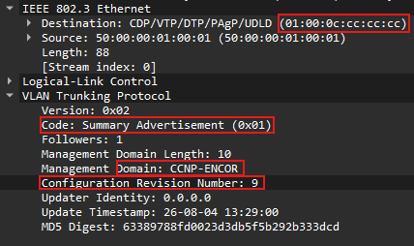
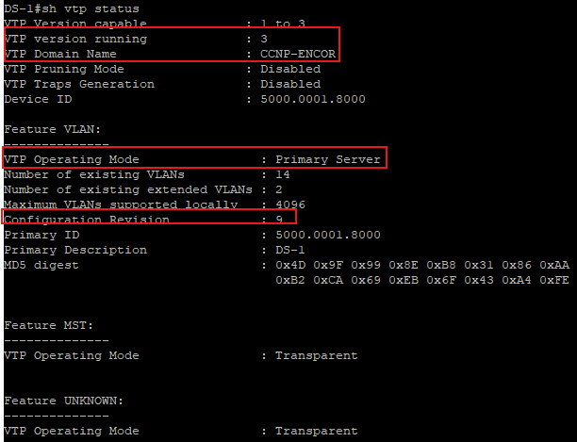
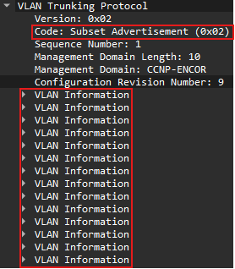
1.VTP
VTP Configuration
Define vtp version with vtp version {1|2|3}
Define vtp domain with command vtp domain domain-name.Changing domain name resets local switches revision number to zero (0).
Define vtp switch role with vtp {server|client|transparent|none.
(Optional) Secure vtp domain with command vtp password password
Verify VTP
Show vtp status
VTP communication packets examples:
Summary Advertisement
Subset Advertisment

Slide 4


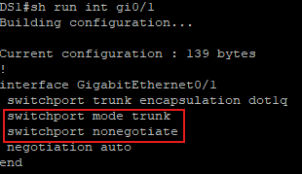
2.DTP
Dynamic Trunking Protocol (DTP)
Trunk ports between switches are established by sending DTP packets every 30 seconds to check if both end of the link can negotiate to form trunk ports.
DTP require that the VTP domain match between the switches.
Three modes for setting a port as a trunk:
Trunk: Statically place switchport to trunk and advertises DTP packets to other side to establish dynamic trunk link.
To set port to statically trunk use switchport mode trunk.
Dynamic Desirable: Switchport acts as an access port and listens for and advertises DTP packets to negotiate dynamic trunk link. Successful negotiation places the port as trunk. To set switchport as dynamic desirable use switchport mode dynamic desirable.
Dynamic Auto: Switchport acts as access port, but listens for DTP packets to form dynamic trunk link. To set port to dynamic auto use switcport mode dynamic auto.
Matrix to form trunk link
To verify trunk status use show interfaces trunk
Statically setting port mode to trunk shows mode as “on”.
Best practice is to set both side of the link statically to trunk.
And set them to not negotiate the trunk formation with command switchport nonegotiate
This command prevents the ports from staying in undesirable mode.
Switch1 | Switch 2 | Trunk | Dynamic desirable | Dynamic Auto
Trunk |  | Yes | Yes | Yes
Dynamic Desirable |  | Yes | Yes | Yes
Dynamic Auto |  | Yes | Yes | No

Slide 5
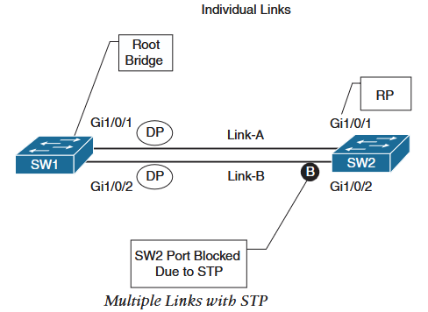
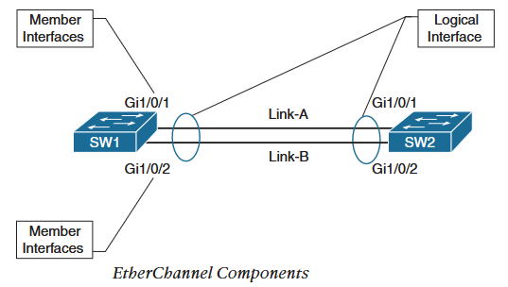
3.EtherChannel Bundles
EtherChannel Bundles / PortChannel
Using multiple links between switches increases the available bandwidth, however, STP puts alternate links between switches in blocking state.
Multiple physical links can be bundled together into single logical link known as etherchannel or port channel.
STP operates on logical links(etherchannel) thus provides increased bandwidth without blocking any of the physical (member) interfaces.
Etherchannels can be formed by setting them statically to on state or using dynamic link aggregation protocol.
Statically setting to on does not provide health integrity check, which can lead to sporadic (random) packet loss when any of the member interfaces degrades but still keeping etherchannel in up sate.
Dynamic Link Aggregation Protocols
Port Aggregation Protocol (PAgP): Cisco proprietary protocol that advertises messages to multicast MAC address 0100.0CCC.CCCC and protocol code 0x0104. Two modes:
Auto: Does not advertise but only listens for PAgP packets to form etherchannel. Both devices in Auto cannot form etherchannel dynamically.
Desirable: Advertises and listens for PAgP packets to dynamically form etherchannel. Other side device in either Auto or Desirable mode can form etherchannels dynamically.

Slide 6
3.EtherChannel Bundles
Link Aggregation Control Protocol (LACP) : Open industry standard that advertises messages to multicast MAC address 0180.C200.0002 . Two modes of operation:
Passive: Does not advertise but only listens for LACP packets to form Etherchannel. Both devices in passive mode does not form etherchannel.
Active: Advertises and listens for LACP packets to establish etherchannel. Active LACP device can form etherchannel if other side device is in Active or Passive LACP mode.
EtherChannel Configuration: Configure etherchannels by entering interface configuration mode and assigning them to an Etherchannel ID.
Static EtherChannel: Static etherchannel is configured in interface configuration mode with channel-group channel-group-id mode on.
LACP EtherChannel: Configured with interface parameter command channel-group channel-group-id mode {active|passive}.
PAgP EtherChannel: Configured with interface parameter command channel-group channel-group-id mode {auto|desirable} [non-silent].
non-silent keyword requires the device to receive PAgP packets before establishing etherchannel.While without the keyword, PAgP port operates in silent mode that rarely sends PAgP packets and allows to form etherchannel with PAgP incapable devices.
Factors needs to be considered for EtherChannel configuration:
Configuration settings for etherchannel are placed in portchannel configuration mode. Such as setting port-channel to trunk mode as below:
SW1(config)#Interface port-channel 1
SW1(config-if)#Switchport mode trunk
Member interfaces needs to be in appropriate layer 2 or layer 3(no switchport) for respective layer 2 or layer 3 etherchannel.

Slide 7
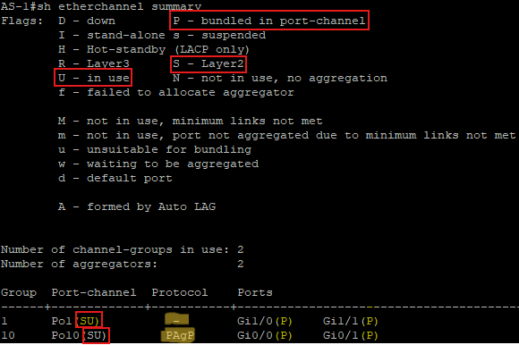
3.EtherChannel Bundles
EtherChannel Verification : Use show etherchannel summary
Port-channel 1 is configured statically with mode on, therefore it shows ‘-’ under protocol.
Port-channel 10 is configured with PAgP Auto mode, therefore it shows ‘PAgP’ under protocol.
For any layer 2 port channel to be operating normally it should be listed with (SU) flags and member interface with (P) flag.
Logical EtherChannel Interface (Port-channel) flags:
+
Member Interface Flags:
Show interfaces port-channel port-channel-id shows detailed information about the port-channel including aggregated bandwidth and member interfaces.
Field | Description
P | The interface is actively participating and forwarding traffic for this port channel.
H | Port channel is configured with maximum number of active interfaces. This interface is participating in LACP with remote peer but is not forwarding traffic and is acting as a hot-standby. Command lacp max-bundle number-member-interfaces is configured on port-channel.
I | Interface has not detected any LACP activity and is operating as an individual interface.
w | Indicates there is time left to receive LACP packet from neighbor to ensure that it is still active.
s | Interface is in suspended state.
r | Switch module associated with this interface has been removed from chasis.
Field | Description
U | The EtherChannel interface is working properly.
D | The EtherChannel interface is Down,
M | Successfully established at least one LACP adjacency, but is configured with minimum number of member interfaces with command port-channel min-links min-number-interfaces. M indicates the configured minimum number of member interfaces exceeds active interfaces in port-channel.Port-Channel does not transmit any traffic with this flag.
S/R | Port-channel is configured for layer 2 switching/configured for Layer 3 routing.

Slide 8
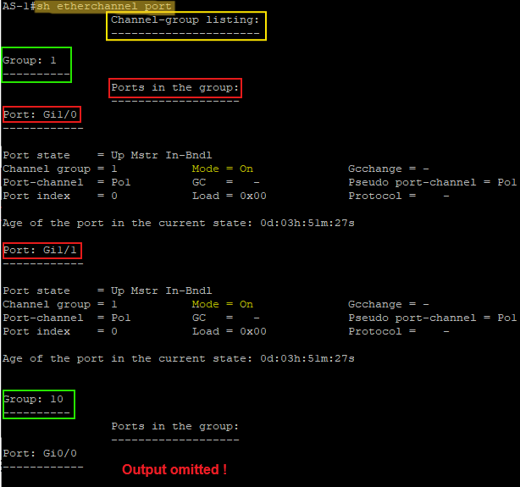
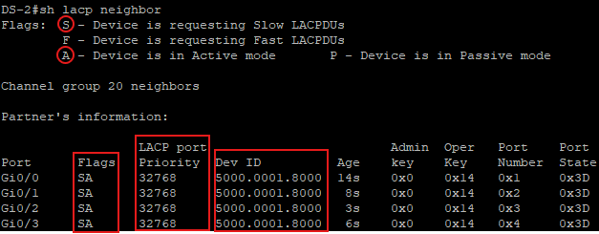
3.EtherChannel Bundles
Viewing Etherchannel Neighbors : Use show etherchannel port
Heading of the output shows channel group listing as list of channel groups in the device.
This switch has 2 portchannel (po1 and po10), Each group’s member interfaces are listed under each group heading.
Output as above contains too much information and can slow down troubleshooting when less information is required.
Commands such as show lacp neighbor [detail] shows information about neighbors system id, system priority and whether it is using slow or fast LACP packet intervals.
Show lacp neighbor [detail]
This output shows information about the remote device. Here, as per the flags SA, remote device is requesting slow LACP packets and is configured in Active mode.
The ‘Dev ID’ is the device id that is used to identify that the port channel is not split across different devices.
Local system id can be viewed by using show lacp sys-id
DS-2#sh lacp sys-id
32768, 5000.0002.8000

Slide 9
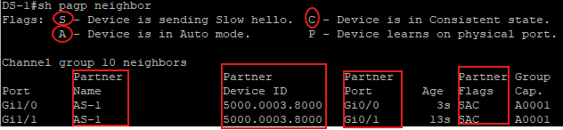
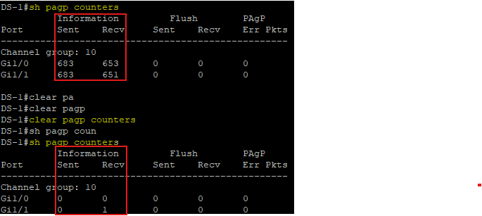
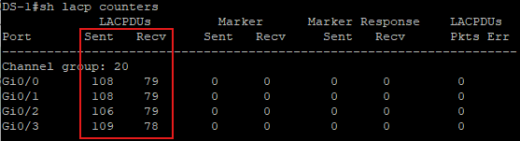
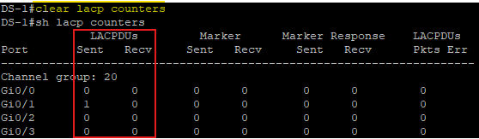
3.EtherChannel Bundles
Similarly, show pagp neigbor command can be used to see details about PAgP remote device.
Verifying EtherChannel Packets:
LACP packets that are sent and received can be viewed with show lacp counters command.
For port-channel to be healthy, sent and received LACP packets must be increasing.
LACP counters can be cleared with clear lacp counters command.
Show pagp counters command shows details about PAgP packets.

Slide 10
3.EtherChannel Bundles
Advanced LACP configuration options:
LACP Fast
LACP provides some additional tuning that are not available with PAgP.
LACP standard sends packets every 30 seconds and puts interface as not reachable after 90 seconds (3 LACP packets missing).
Modification of standard behavior is done by configuring LACP in fast mode that sends packets every second and puts interface as not reachable after 3 seconds.
LACP fast is enabled on every member interfaces under interface parameter mode with lacp rate fast command.
show lacp internal command can be used to verify the LACP packet speed.
Minimum Number of Port-Channel Member Interfaces
Can be configured with port-channel min-links min-links under port-channel interface configuration.
Minimum number of links does not need to be configured on both devices but it is recommended to maintain consistency.
Maximum Number of Port-Channel Member Interfaces
Can be configured with lacp max-bundle max-links under port-channel interface configuration mode.
Maximum number of links in a port-channel can be configured only on master device.
However, it is recommended to configure on both devices for consistency.
The master device controls which interfaces can be active by using LACP port priority. Lower port priority then lower port number is preferred.
Configuring lacp max-bundle 3 in DS-1 switch’s port-channel 20 can be verified as below:
DS-1# show etherchannel 20 summary
Group Port-channel Protocol Ports
------+-------------+-----------+-----------------------------------------------
20 Po20(SU) LACP Gi0/0(P) Gi0/1(P) Gi0/2(P)
Gi0/3(H)
DS-2# show etherchannel 20 summary
Group Port-channel Protocol Ports
------+-------------+-----------+-----------------------------------------------
20 Po20(SU) LACP Gi0/0(P) Gi0/1(P) Gi0/2(P)
Gi0/3(w)

Slide 11
3.EtherChannel Bundles
Advanced LACP configuration options:
LACP System Priority:
It identifies which switch is master for the port channel.
Switch with lower system priority is preferred to be master and it controls which interfaces can be active when there are more interfaces than the configured max-bundle.
LACP system priority can be configured with lacp system priority priority (range from 0 -65535)
DS-1#show lacp sys-id
32768, 5000.0001.8000
DS-1#conf t
Enter configuration commands, one per line. End with CNTL/Z.
DS-1(config)#lacp system-priority 1
DS-1#sh lacp sys-id
1, 5000.0001.8000
LACP Interface Priority:
LACP interface priority enables master switch to choose which interface to put as active when there are more interfaces than the maximum number of member interfaces.
Lower interface priority is preferred and interface number (lower preferred as well) is used as tie breaker for equal interface priority.
Interface configuration command lacp port-priority priority sets the interface priority for LACP.
DS-1#sh etherchannel 20 summary | b Group
Group Port-channel Protocol Ports
------+-------------+-----------+-----------------------------------------------
20 Po20(SU) LACP Gi0/0(P) Gi0/1(P) Gi0/2(P)
Gi0/3(H)
DS-1(config)#int gi0/3
DS-1(config-if)#lacp port-priority 1
DS-1#sh etherchannel 20 summary | b Group
Group Port-channel Protocol Ports
------+-------------+-----------+-----------------------------------------------
20 Po20(SU) LACP Gi0/0(P) Gi0/1(P) Gi0/2(H)
Gi0/3(P)

Slide 12
3.EtherChannel Bundles
Troubleshooting EtherChannel Bundles:
As a general rule, place interfaces to appropriate switchport type (layer 2 or layer 3) and associate member interfaces with appropriate etherchannel group.
All other port-channel configuration should be done under port-channel interface.
Following configuration settings must match on member interfaces:
Port Type: Every member interfaces must be configured to layer 2 or layer 3 port type.
Port Mode: Layer 2 port channels must be configured either as access port or trunk port, they cannot be mixed.
Native VLAN: Member interfaces on layer 2 trunk port- channel must be configured with matching native vlan with command switchport trunk native vlan vlan-id.
Allowed VLAN: Member interfaces on layer 2 trunk port channel must be configured with same allowed vlans with command switchport trunk allowed vlan-ids.
Speed: All member interfaces must be same speed.
Duplex: Duplex must be same on all member interfaces.
MTU: All member interfaces of layer 3 etherchannel must match their MTU. Interfaces with different MTU cannot be added to the etherchannel bundle.
Load Interval: Interval at which the load on the interface is calculated (default 300 seconds) must match on member interfaces.
Storm Control: Storm (limit of broadcast,multicast and unknown unicast flooding) control settings must match on all member interfaces.
In addition to above member interface settings check below to establish etherchannels successfully.
Ensure that a member link is between only two device.
Ensure that the member link is active.
Ensure both side are set to ‘on’ or LACP with atleast one side ‘Active’ or PAgP with atleast one side ‘Desirable’.
Except for LACP port priority, ensure that all member interfaces are consistently configured.
Verify LACP and PAgP packet transmission and receipt on both ends.

Slide 13
3.EtherChannel Bundles
Loadbalancing Traffic with EtherChannel Bundles:
Traffic that flows across a port-channel interface is not forwarded in a round robin fashion among the member links.
Instead, a hash of the packets header is calculated to consistently forward traffic across a link.
The loadbalacing hash is a system-wide configuration with command port-channel load-balance hash. Hash has below keyword choices:
dst-ip: Destination IP
dst-mac: Destination mac address
dst-mixed-ip-port: Destination ip address and destination UDP/TCP port
dst-port: Destination UDP/TCP port
src-dst-ip: Source and destination ip addresses
src-dest-ip-only: Source and destination ip addresses only
src-dst-mac: Source and destination mac addresses
src-dst-mixed-ip-port: Source and destination ip address and source and destination UDP/TCP ports.
src-dst-port: Source and destination ports only
src-ip: Source ip address
src-mac: Source MAC address
src-mixed-ip-port: Source ip address and source UDP/TCP port
src-port: Source UDP/TCP port
Show etherchannel load-balance shows a switch will load balance based on traffic type.
DS-1#sh etherchannel load-balance
EtherChannel Load-Balancing Configuration:
src-dst-ip
EtherChannel Load-Balancing Addresses Used Per-Protocol:
Non-IP: Source XOR Destination MAC address
IPv4: Source XOR Destination IP address
IPv6: Source XOR Destination IP address
Even number of member interfaces (2,4,8) will effectively load-balance the traffic than with port-channel that has odd number (eg. 3) member interfaces.
Show etherchannel port shows the load-balance as a hex value of relative link utilization of each member link compared to others.

